Slide 1
Pine Hill Middle School
State of the School Address 2021-2022

Slide 2
Richmond County School System Mission/Vision
Mission Statement
Building a globally competitive school system that educates the whole child through teaching, learning, collaboration, and innovation.
Vision Statement
The Richmond County School System will provide an equitable education for all students to prepare them for life beyond the classroom.

Slide 3
Pine Hill Middle School Mission, Vision, and Theme
The Mission- Building a globally competitive school that educates the whole child through teaching, learning, collaboration, and innovation.
The Vision- Pine Hill Middle School will provide an equitable education for all students to prepare them for life beyond the classroom.
(RCSS, 2020)
2021-22 Visionary Theme: Accept. Understand. Love. All Panthers!

Slide 4
Pine Hill Middle School
School moto: "Walk Like a Panther!"
PBIS: "Walk Like A Panther – Respectful, Responsible, Positive, and Flexible"

Slide 5
CCRPI

Slide 6
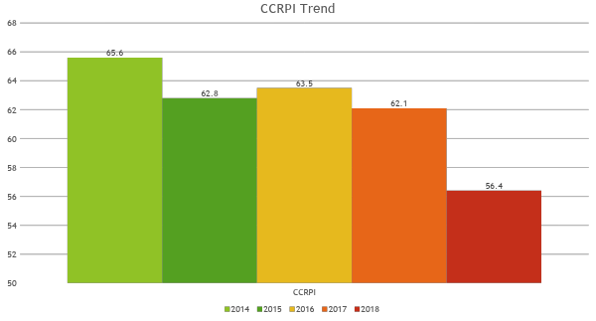

Slide 8
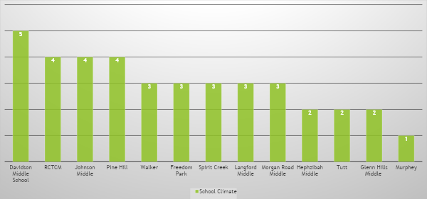
2018 CCRPI Star Rating

Slide 9
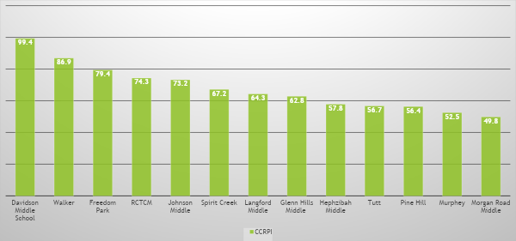
2018 CCRPI

Slide 10
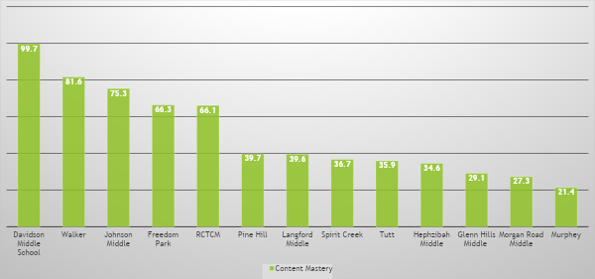
2018 CCRPI Content Mastery

Slide 11
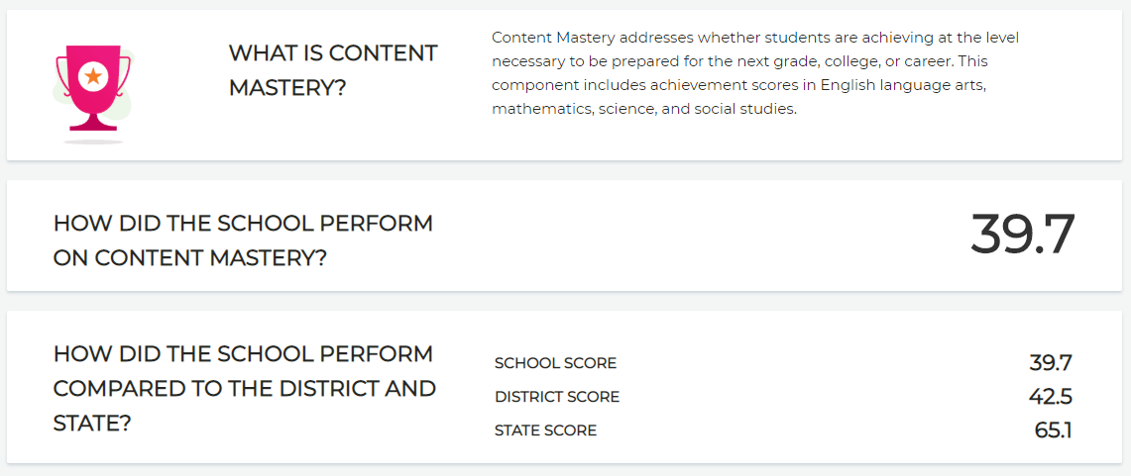

Slide 12
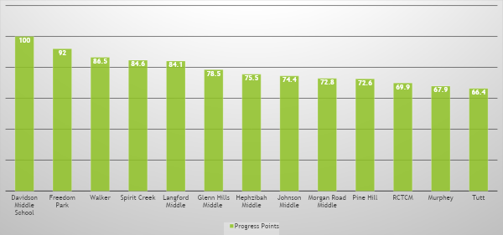
2018 CCRPI Progress Points

Slide 13
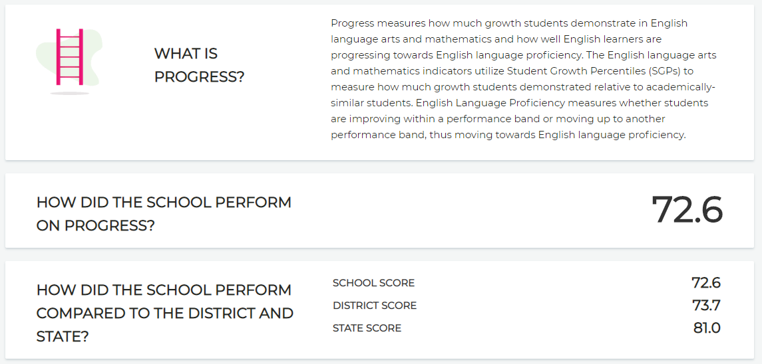

Slide 14
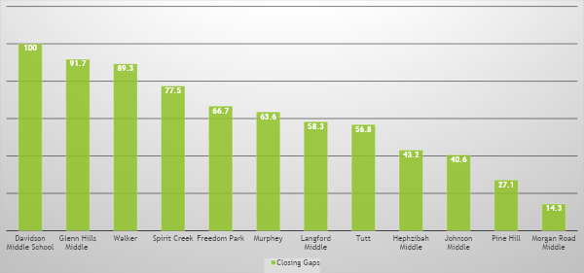
2018 CCRPI Closing Gaps Points

Slide 15
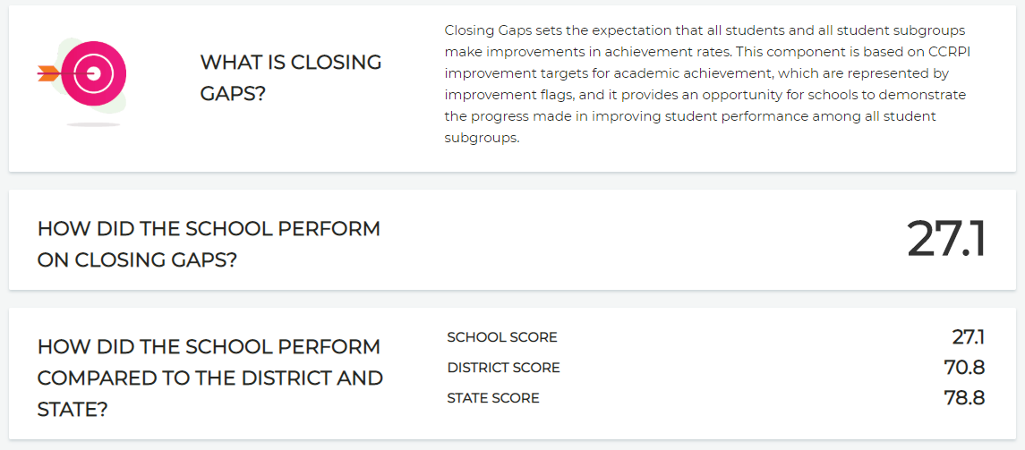

Slide 16
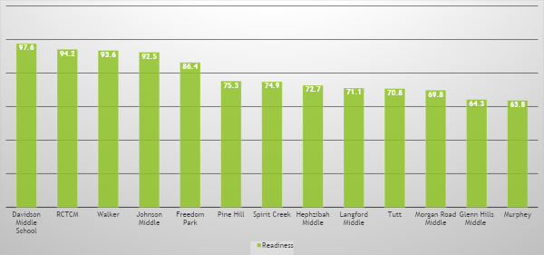
2018 CCRPI Readiness

Slide 17
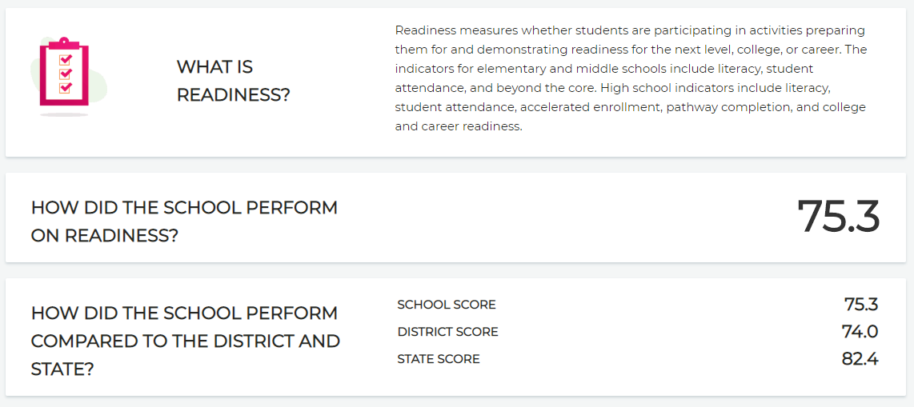

Slide 18
CONTENT DATA
GEORGIA MILESTONES RESULTS

Slide 19
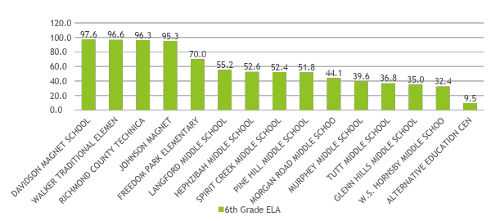
2018 Georgia Milestones Results – 6th Grade English Language Arts – Developing & Above

Slide 20
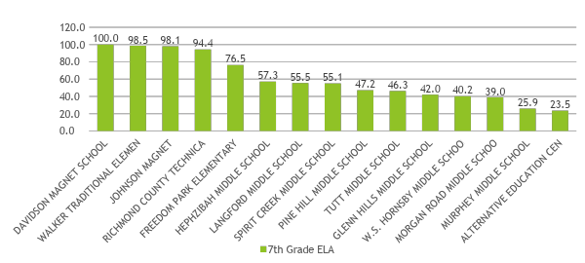
2018 Georgia Milestones Results – 7th Grade ELA – Developing & Above

Slide 21
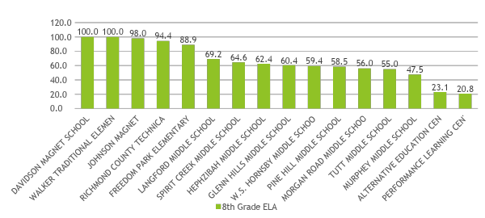
2018 Georgia Milestones Results – 8th Grade ELA – Developing & Above

Slide 22
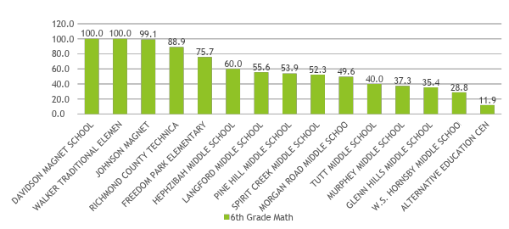
2018 Georgia Milestones Results – 6th Grade Math – Developing & Above

Slide 23
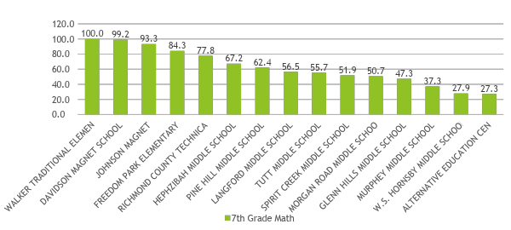
2018 Georgia Milestones Results – 7th Grade Math – Developing & Above

Slide 24
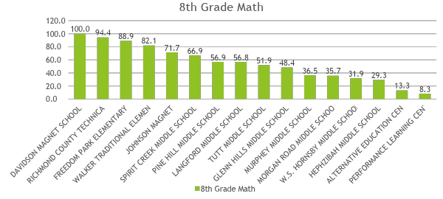
2018 Georgia Milestones Results – 8th Grade Math – Developing & Above – EOC & EOG Combined

Slide 25
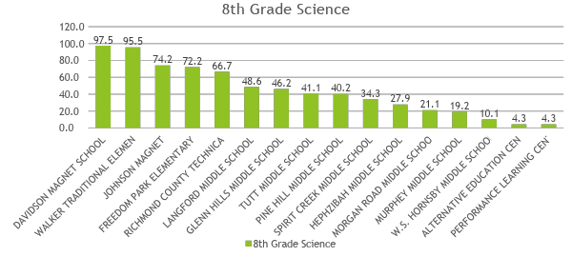
2018 Georgia Milestones Results – 8th Grade Science – Developing & Above – EOG & EOC Combined

Slide 26
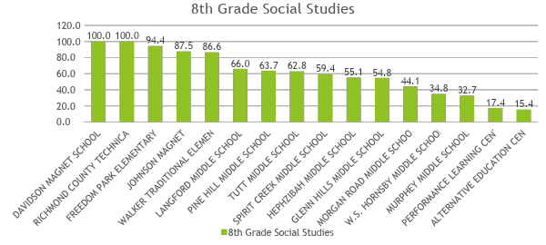
2018 Georgia Milestones Results – 8th Grade Social Studies – Developing & Above

